Slide 1
C7: Fine-tunning LLMs

Slide 2
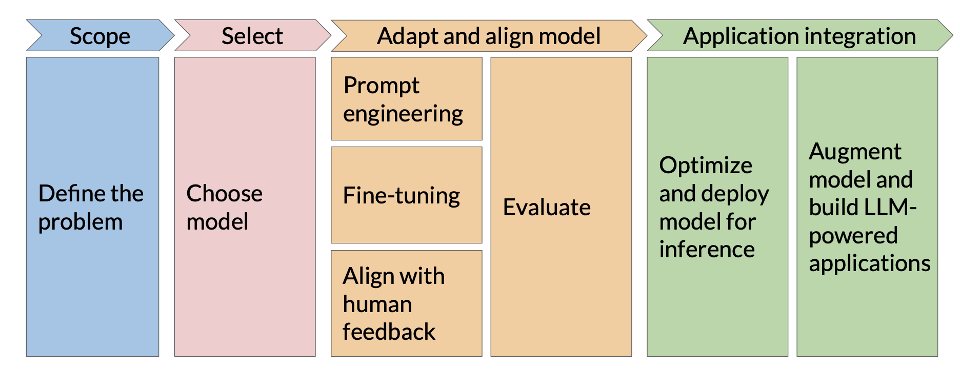
LLM app development lifecycle

Slide 3
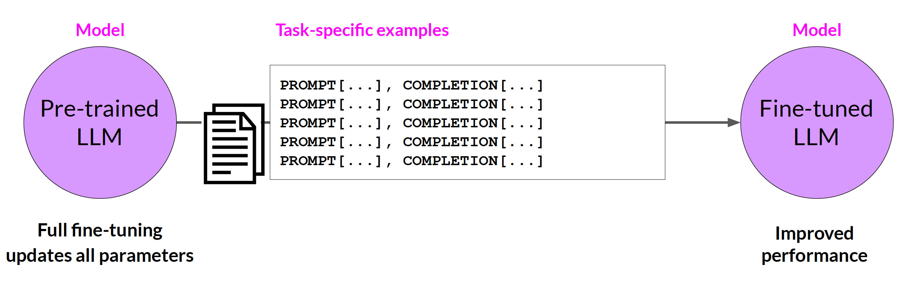
Fine-tunning LLMs
[ref]

Slide 4
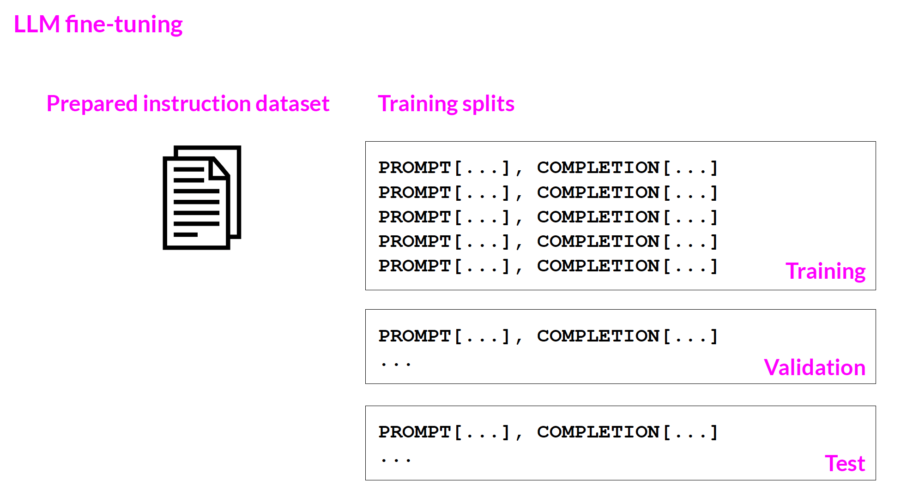
Fine-tunning LLMs
[ref]

Slide 5
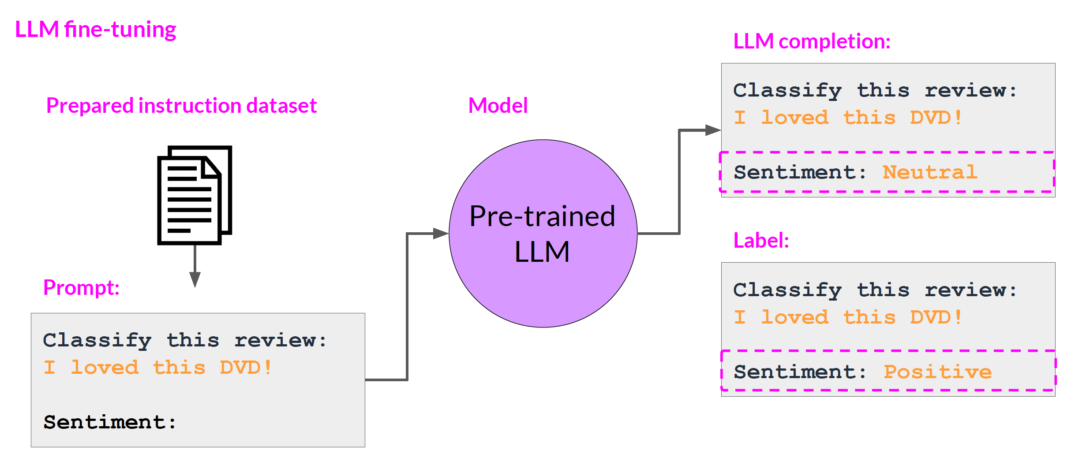
Fine-tunning LLMs
Single task instruction
[ref]

Slide 6
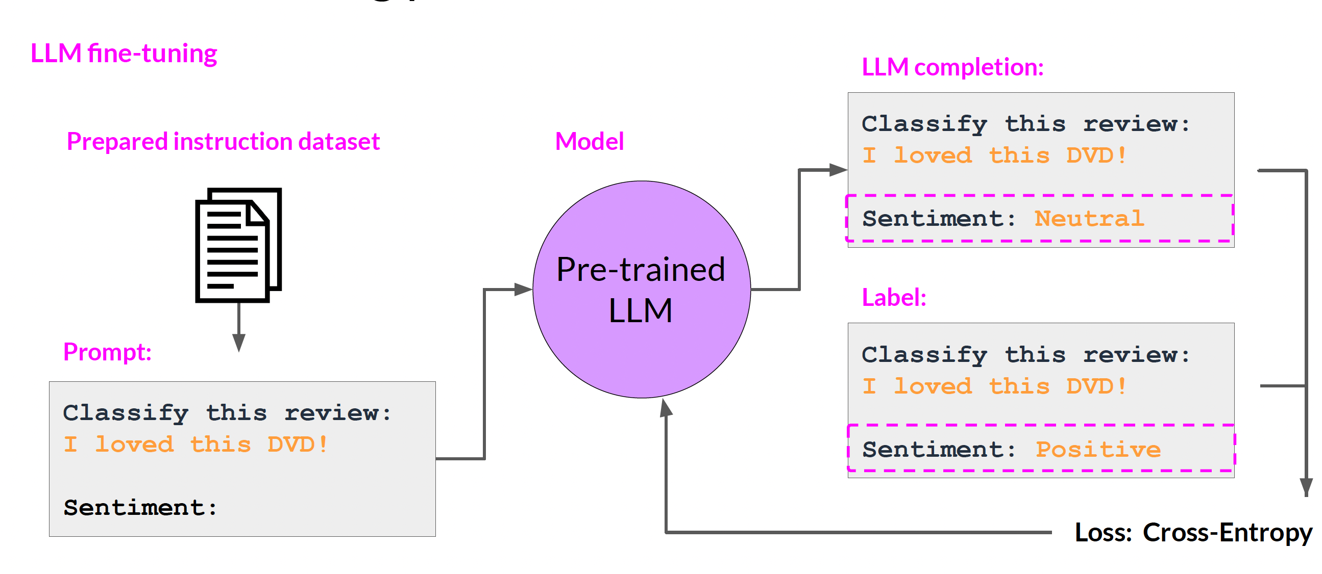
Fine-tunning LLMs
[ref]
loss function - measures how well an AI prediction match the actual target values.

Slide 7
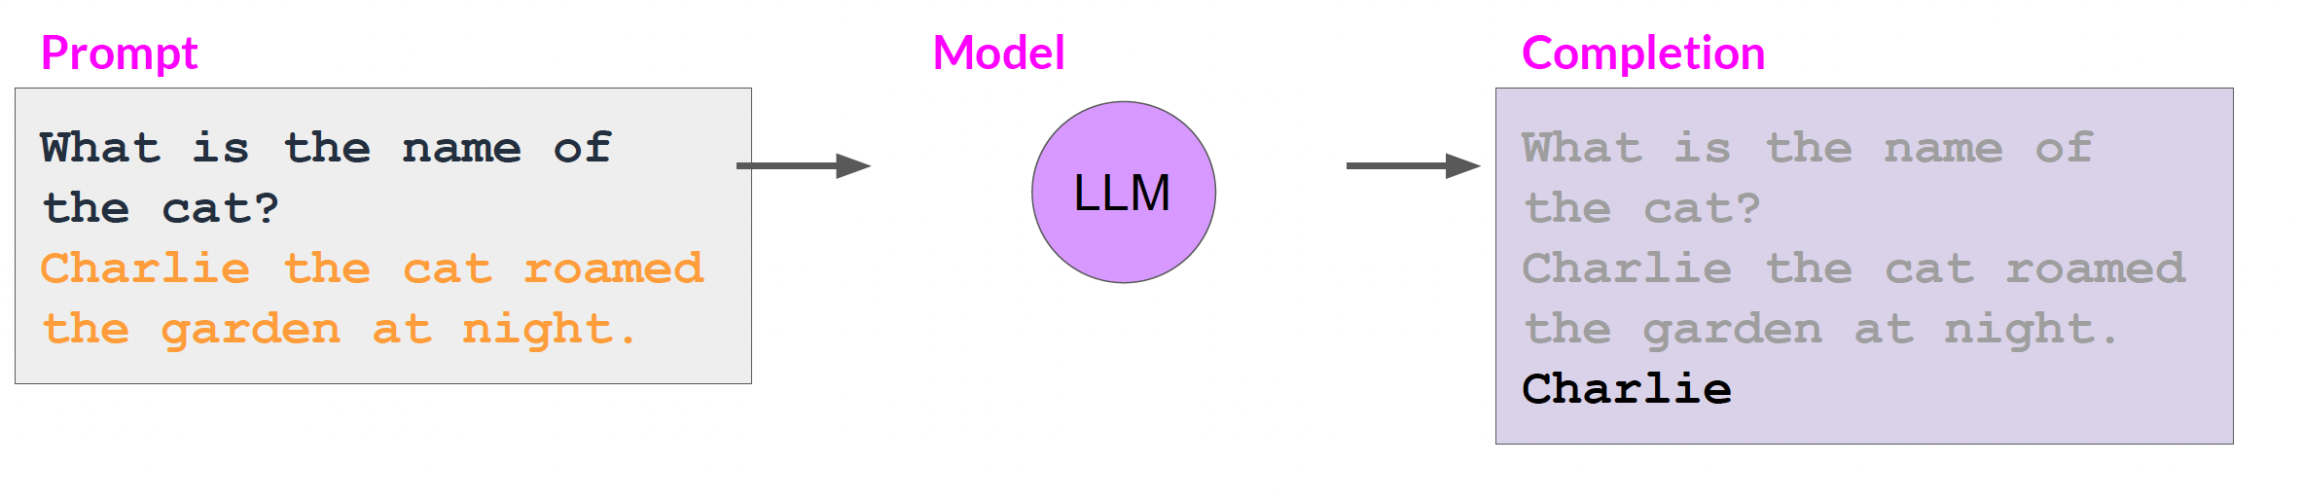
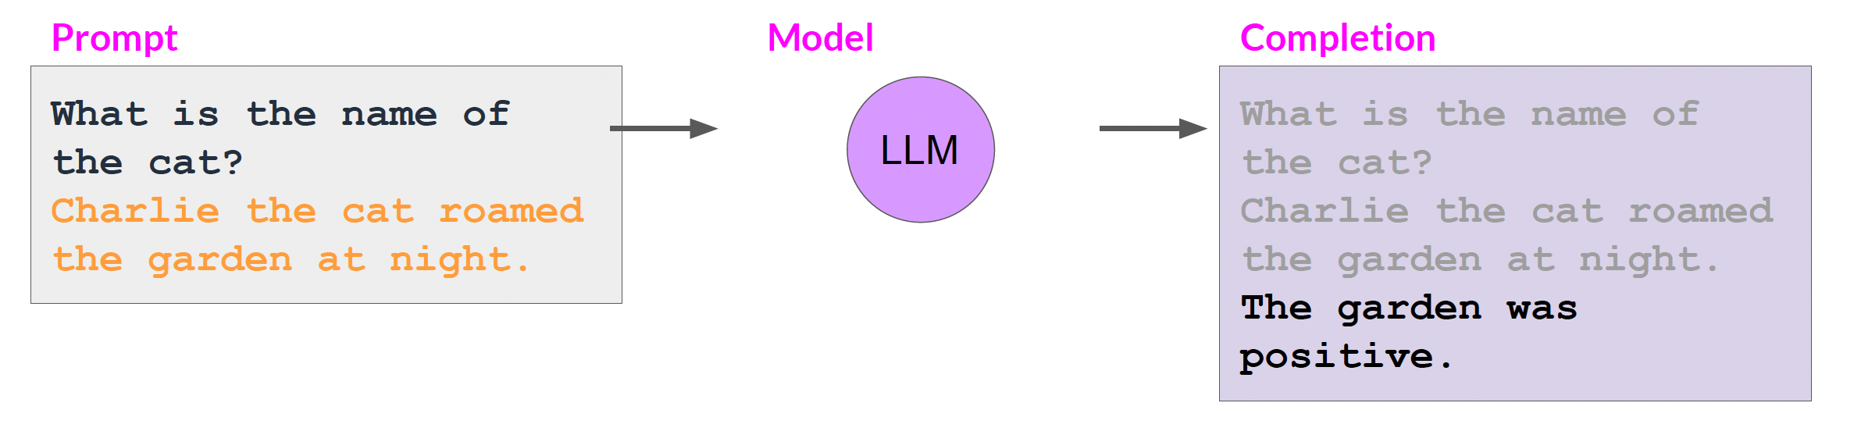
Fine-tunning LLMs
Catastrophic forgetting is a phenomenon in neural networks where the model forgets previously learned tasks after being trained on new data.
Before fine-tunning
After fine-tunning
[ref]

Slide 8
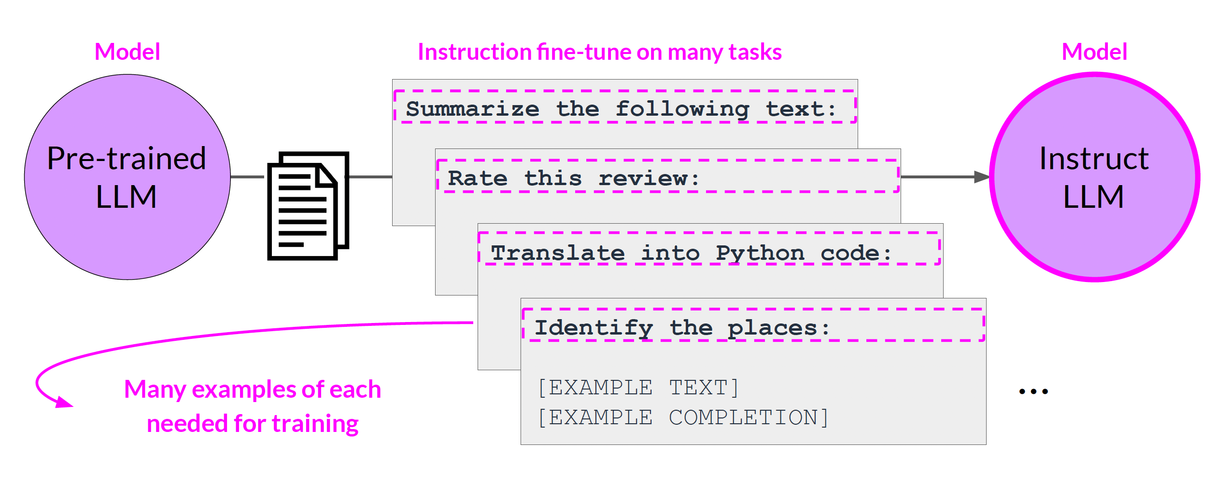
Fine-tunning LLMs
Solution: multi-task instruction
[ref]

Slide 9
Fine-tunning LLMs
Solution: multi-task instruction
[ref]

Slide 10
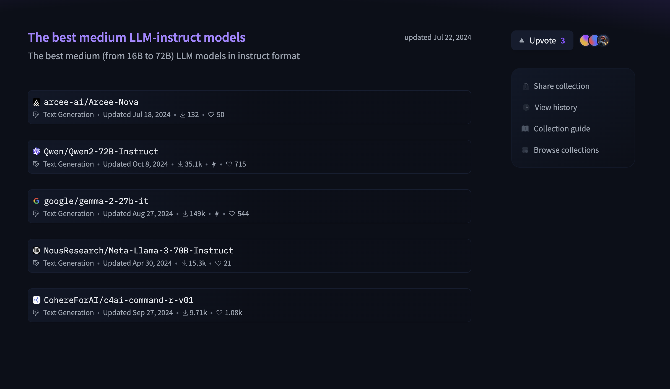
Fine-tunning LLMs
Instruct models are LLMs that have been fine-tuned specifically to follow human instructions in natural language.
Instead of just predicting the next word, an instruct model is trained to understand a task and complete it based on a prompt that looks like a real instruction.
Great option for fine-tunning!
[ref]

Slide 11
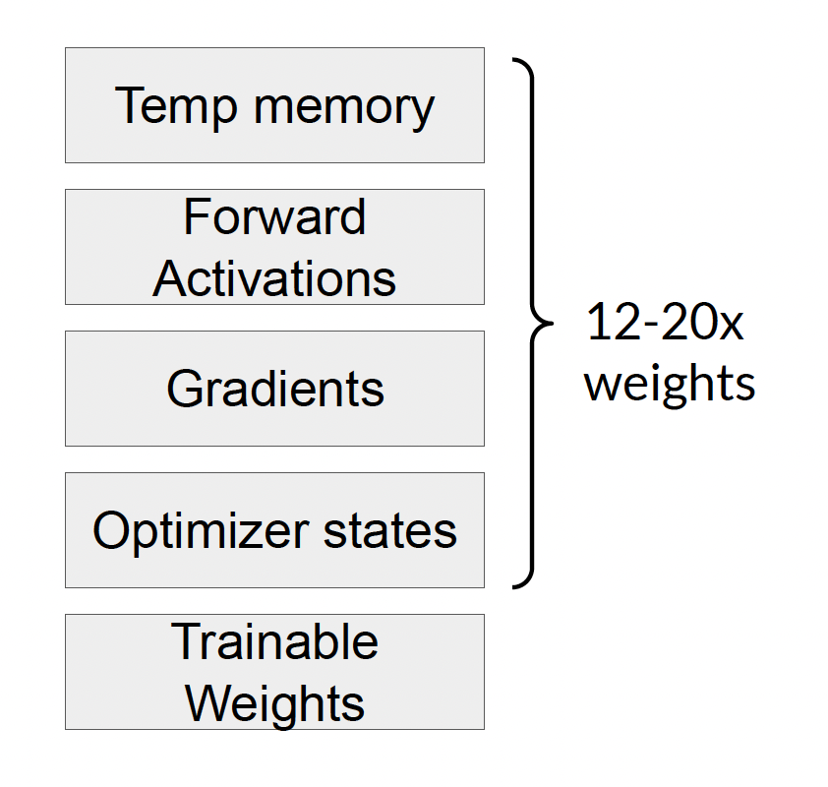
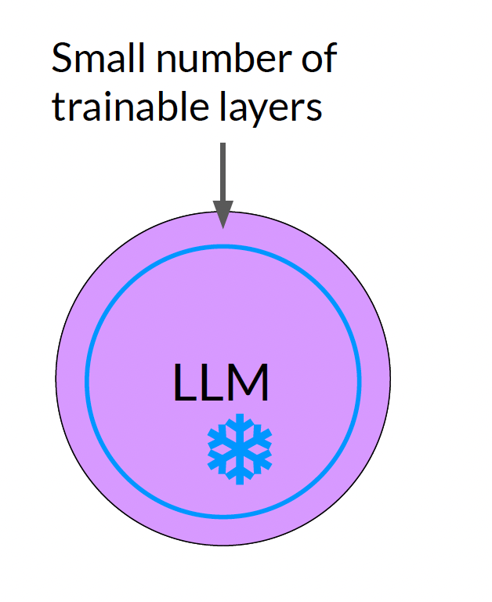
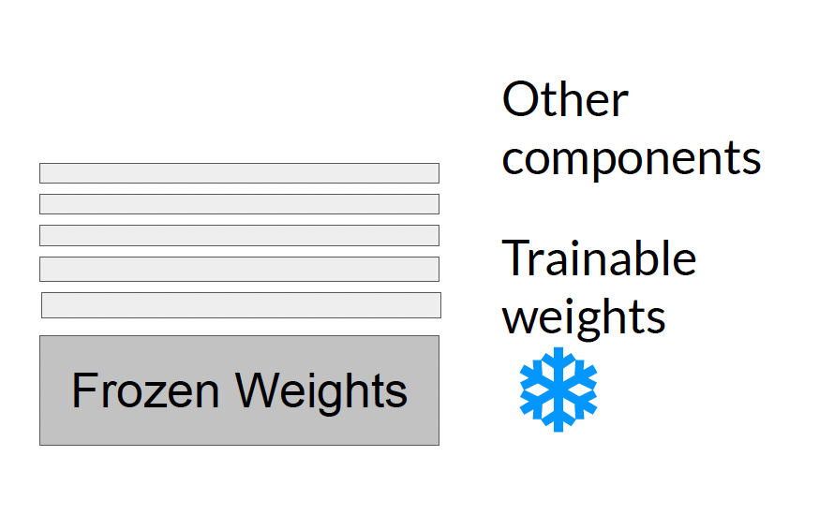
Parameter efficient Fine-tuning (PEFT)
PEFT refers to a family of methods that aim to adapt large pre-trained models to new tasks by tuning only a small subset of parameters, instead of the entire model.
Less prone to
catastrophic forgetting!
[ref]

Slide 12
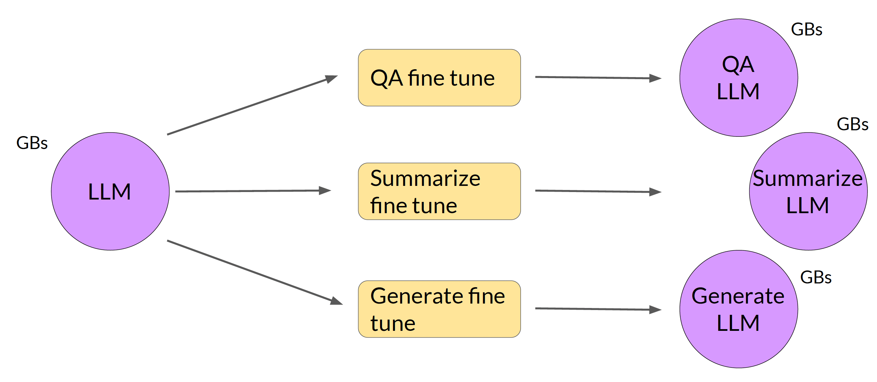
Parameter efficient Fine-tuning (PEFT)
[ref]
Normal fine-tunning process generates new full LLMs.

Slide 13
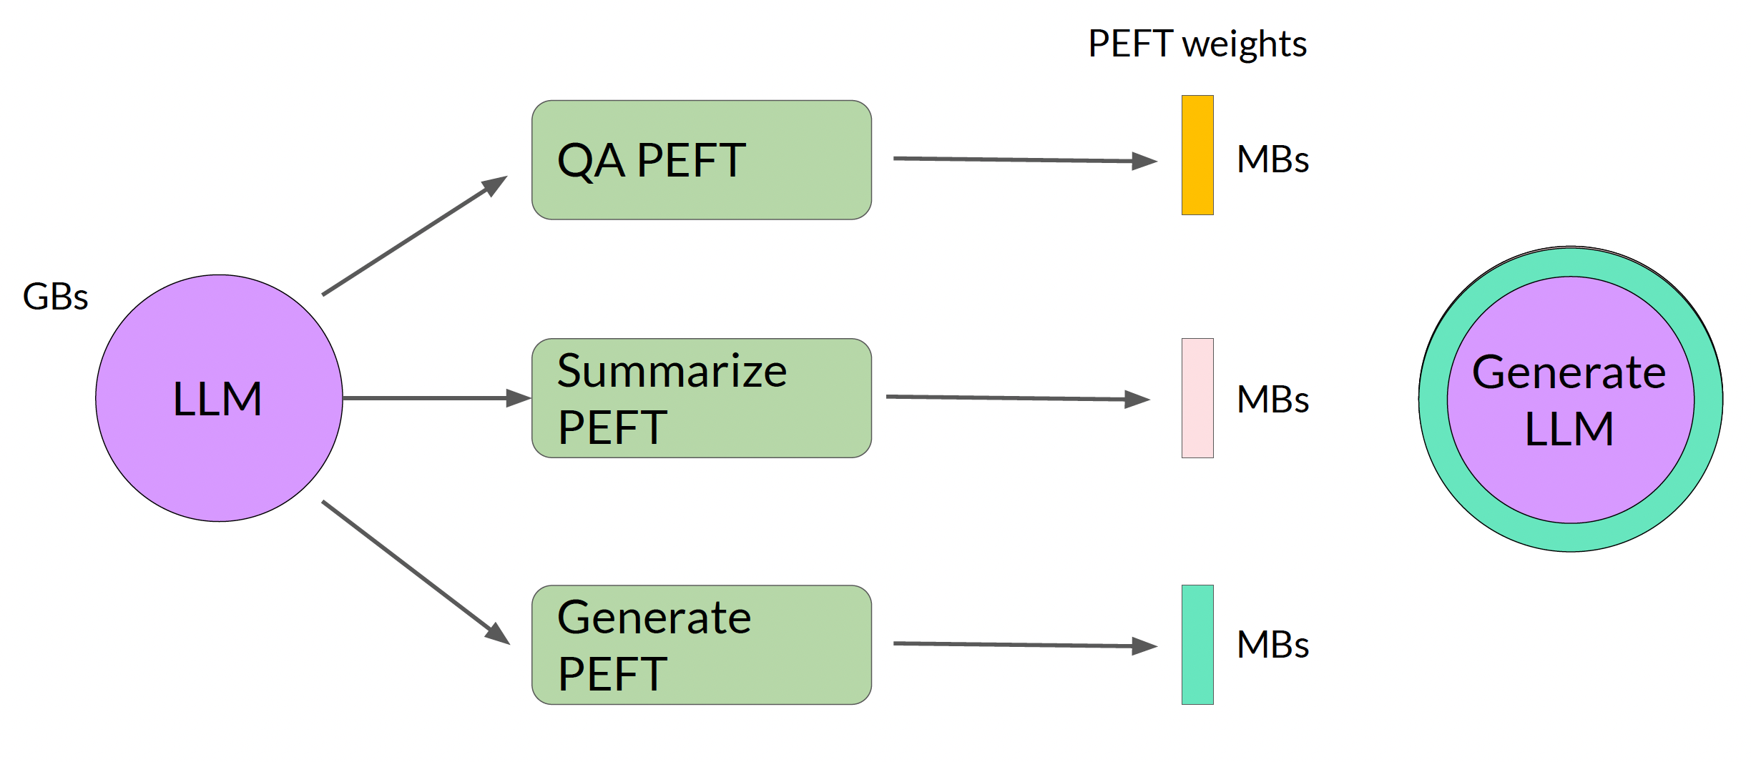
Parameter efficient Fine-tuning (PEFT)
[ref]
PEFT can either select and train specific parameters or generate additive layers!

Slide 14
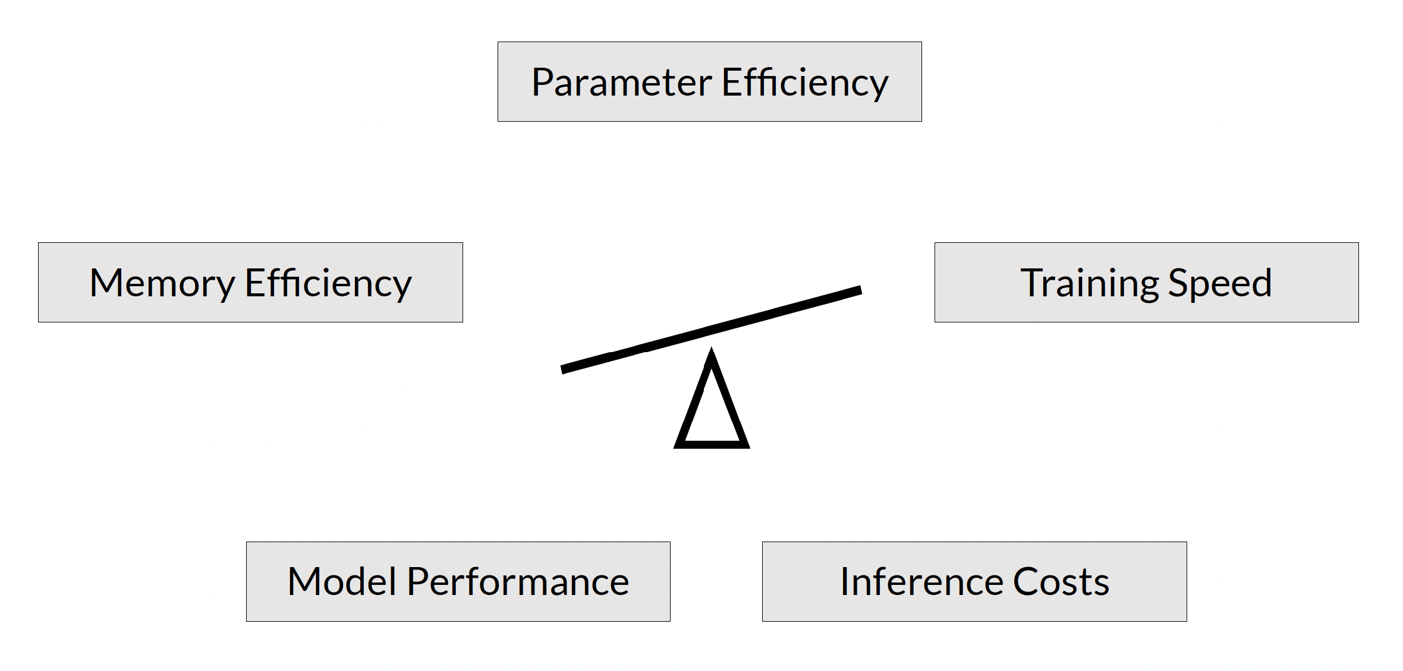
Parameter efficient Fine-tuning (PEFT)
[ref]

Slide 15
Parameter efficient Fine-tuning (PEFT)
[ref]

Slide 16
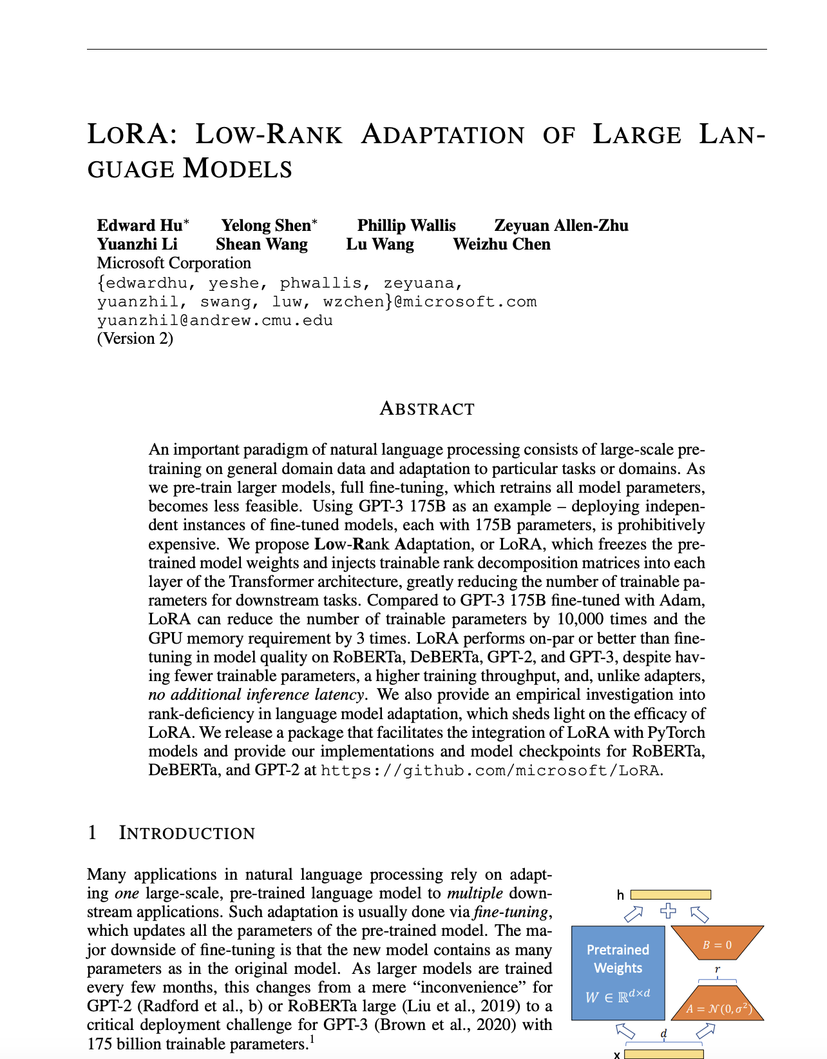
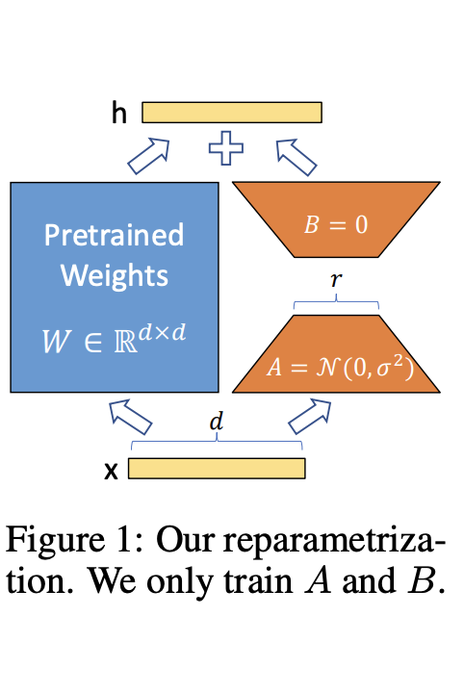
LoRA: Low-Rank Adaptation of Large Language Models
[ref]

Slide 17
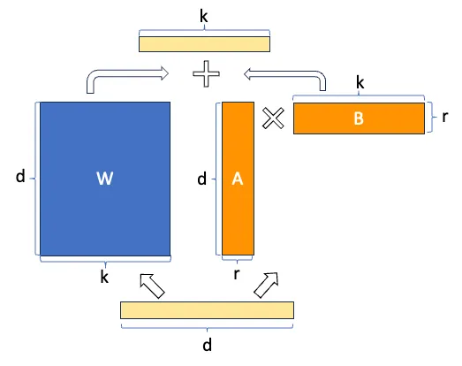
LoRA: Low-Rank Adaptation of Large Language Models
Injects trainable low-rank matrices into the attention layers (Q, K, V, or output projections)
Instead of tuning full weight matrices, it updates a low-rank approximation
[ref]
[ref]

Slide 18
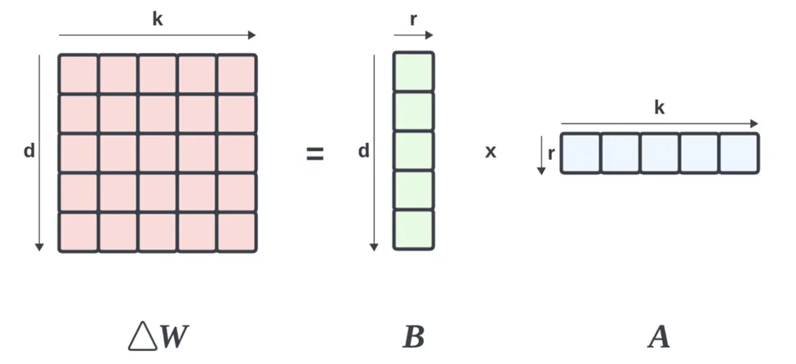
LoRA: Low-Rank Adaptation of Large Language Models
Injects trainable low-rank matrices into the attention layers (Q, K, V, or output projections)
Instead of tuning full weight matrices, it updates a low-rank approximation
5x5 – 25 parameters
LoRA with r=1 – 10 values
~60% less parameters to train!
[ref]
r – rank value ⍺ - scaling coefficient applied to the low-rank update
(rule of thumb: double the size of r)
[ref]

Slide 19
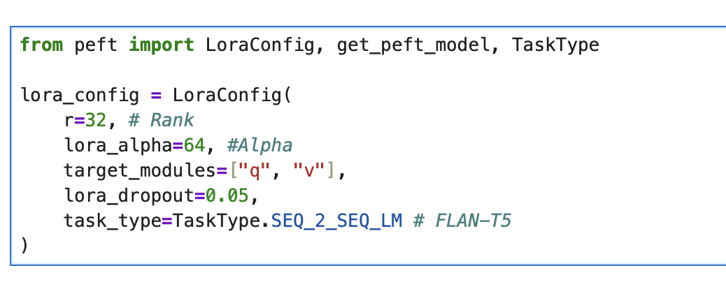
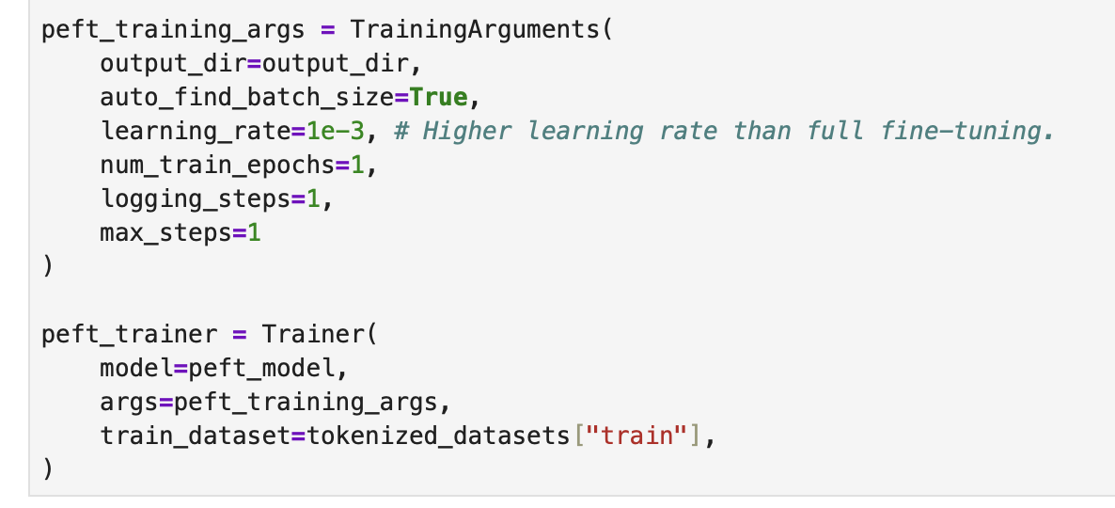
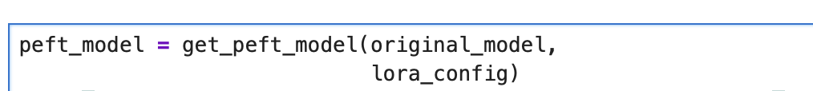
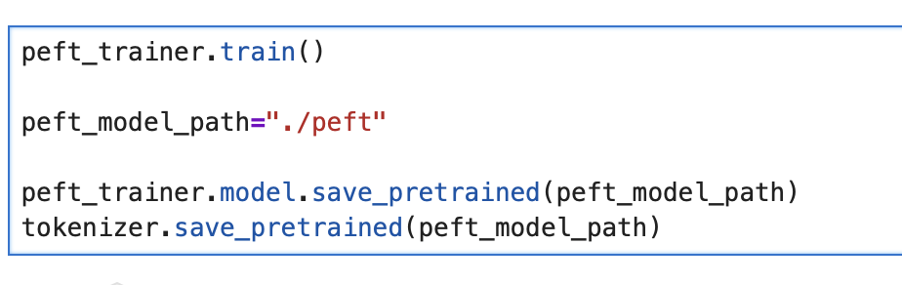
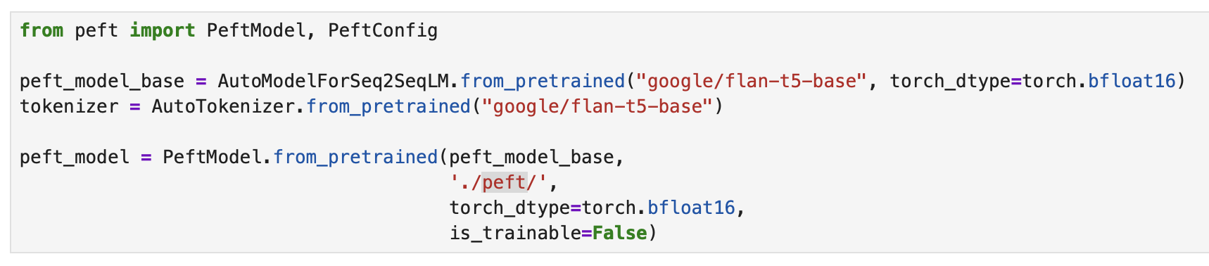
LoRA: Low-Rank Adaptation of Large Language Models
#1
#3
#2
#4
#5

Slide 20
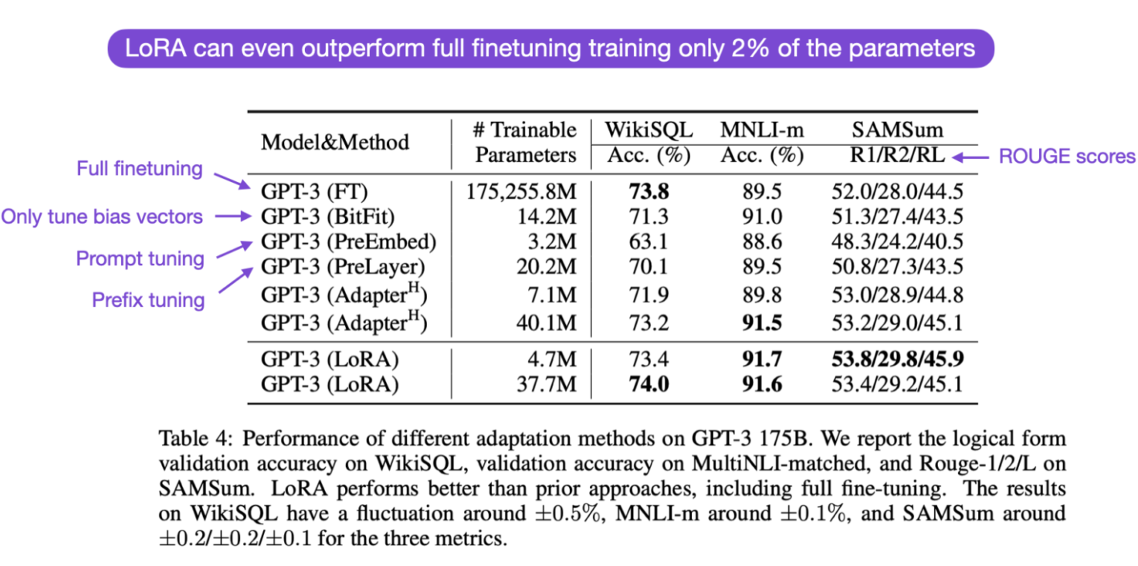
LoRA: Low-Rank Adaptation of Large Language Models
LoRA can be combined with any other fine-tunning method!

